Slide 1
COMPUTER GRAPHICS
Geometric Transformations
Hearn & Baker Chapter 5
Some slides are taken from Robert Thomsons notes.

Slide 2
OVERVIEW
Two dimensional transformations
Matrix representations
Inverse transformations
Three dimensional transformations

Slide 3
Geometric transformation functions
Translation
Rotation
Scaling
Reflection
Shearing
We first discuss the 2D transformations, then we will continue with 3D.

Slide 4
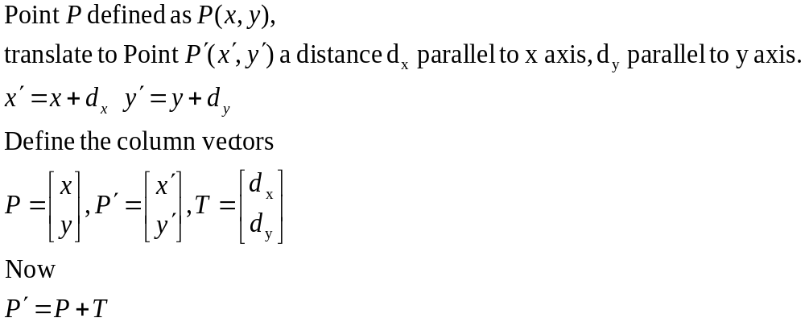
2D Translations
P’
P

Slide 5
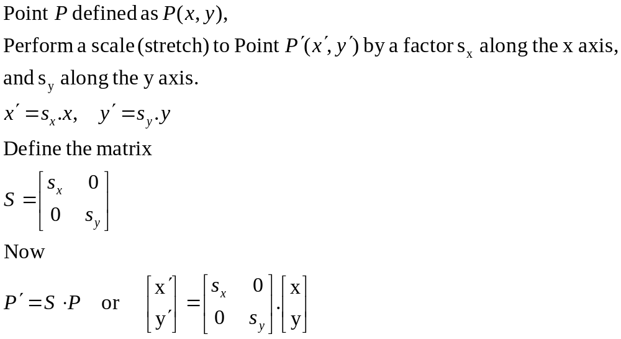
2D Scaling from the origin.
P’
P

Slide 6
2D Rotation about the origin.
y
θ
P’(x’,y’)
P(x,y)
r
r
x

Slide 7
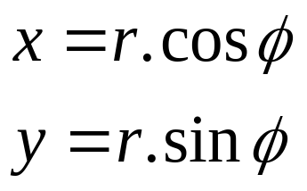
2D Rotation about the origin.
y
P’(x’,y’)
P(x,y)
r
θ
y
φ
r
x
x

Slide 8
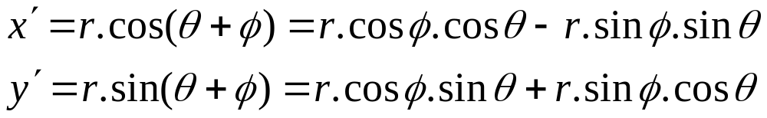
2D Rotation about the origin.
y
P’(x’,y’)
P(x,y)
r
θ
y
φ
r
x
x

Slide 9

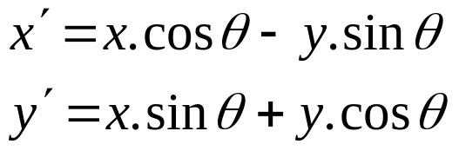
2D Rotation about the origin.
Substituting for r :
Gives us :

Slide 10
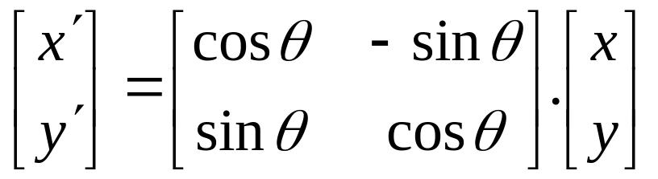
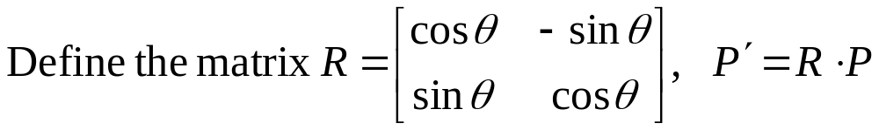
2D Rotation about the origin.
Rewriting in matrix form gives us :

Slide 11
Transformations.
Translation.
  P′=T + P
Scale
  P′=S ⋅ P
Rotation
  P′=R ⋅ P
We would like all transformations to be multiplications so we can concatenate them ⇒ express points in homogenous coordinates.

Slide 12
Homogeneous coordinates
Add an extra coordinate, W, to a point.
  P(x,y,W).
Two sets of homogeneous coordinates represent the same point if they are a multiple of each other.
  (2,5,3) and (4,10,6) represent the same point.
At least one component must be non-zero ⇒ (0,0,0) is not defined.
If W≠ 0 , divide by it to get Cartesian coordinates of point (x/W,y/W,1).
If W=0, point is said to be at infinity.
Notes:
V. important

Slide 13
Homogeneous coordinates
If we represent (x,y,W) in 3-space, all triples representing the same point describe a line passing through the origin.
If we homogenize the point, we get a point of form (x,y,1)
  homogenised points form a plane at W=1.
W
P
W=1 plane
X
Y

Slide 14
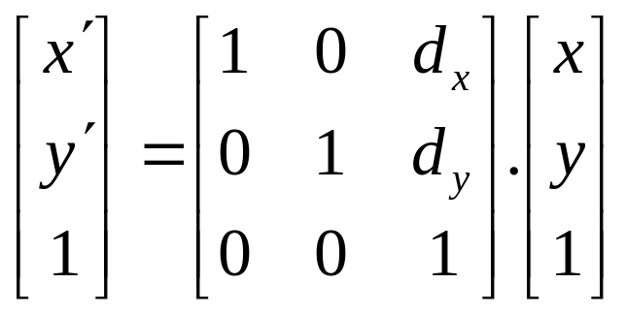
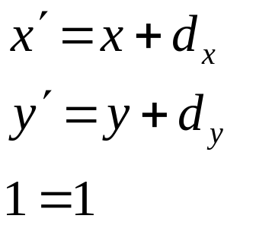
Translations in homogenised coordinates
Transformation matrices for 2D translation are now 3x3.

Slide 15
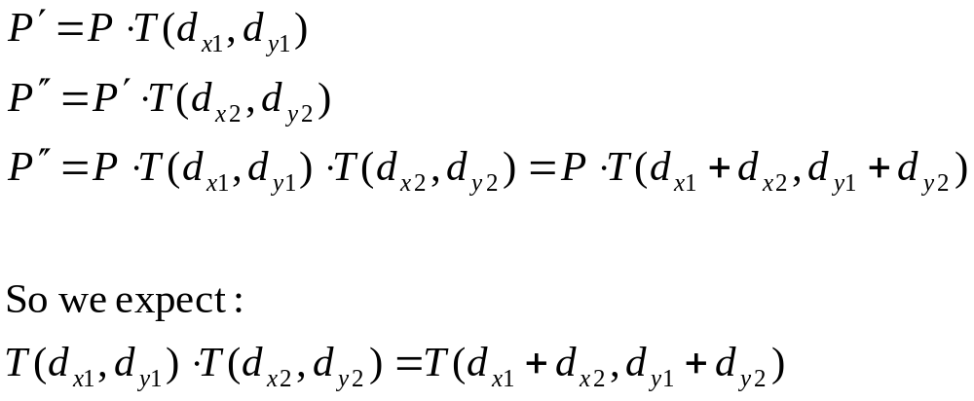
Concatenation.
We perform 2 translations on the same point:

Slide 16
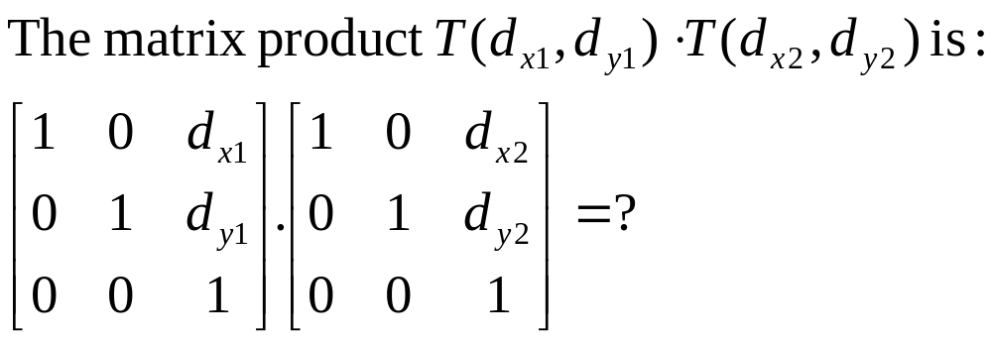
Concatenation.
Matrix product is variously referred to as compounding, concatenation, or composition

Slide 17
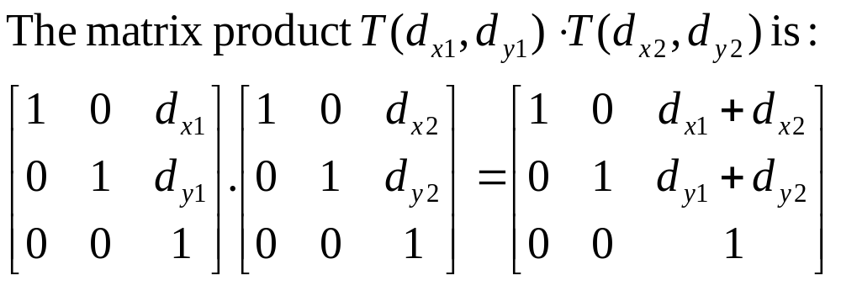
Concatenation.
Matrix product is variously referred to as compounding, concatenation, or composition.
This single matrix is called the Coordinate Transformation Matrix or CTM.

Slide 18
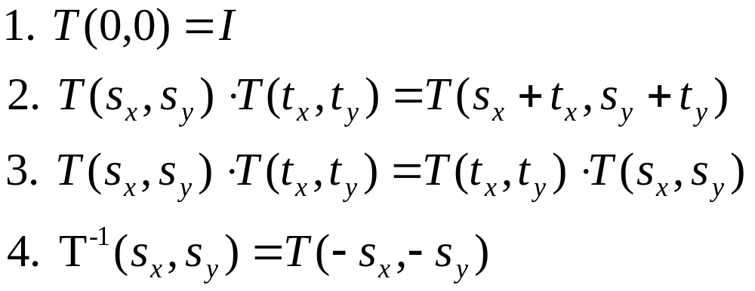
Properties of translations.
Note : 3. translation matrices are commutative.

Slide 19
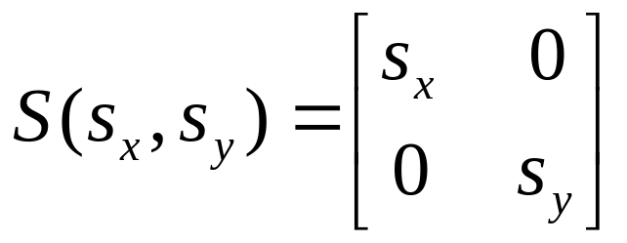
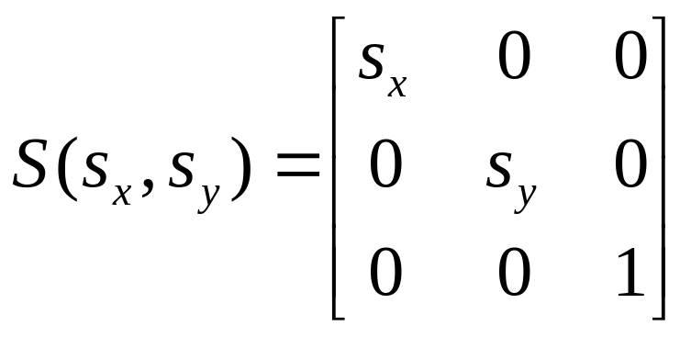
Homogeneous form of scale.
Recall the (x,y) form of Scale :
In homogeneous coordinates :

Slide 20
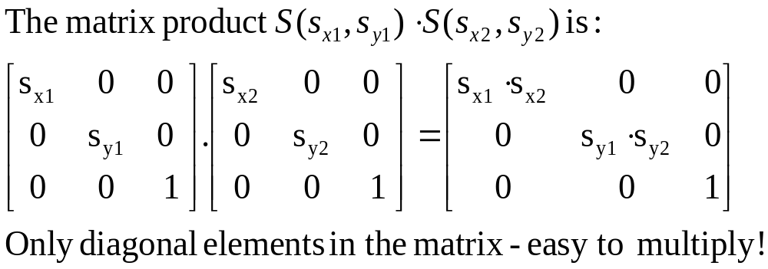
Concatenation of scales.

Slide 21
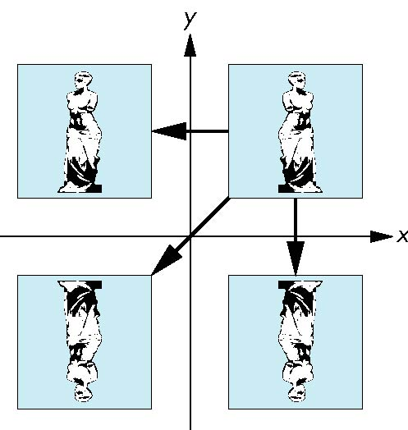
Reflection
corresponds to negative scale factors
s_{x} = -1 s_{y} = 1
original
s_{x} = -1 s_{y} = -1
s_{x} = 1 s_{y} = -1

Slide 22
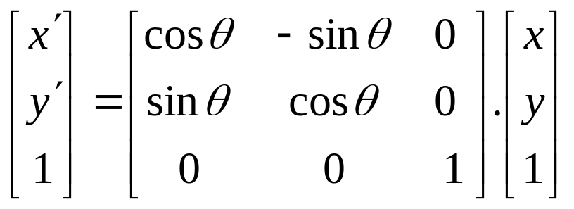
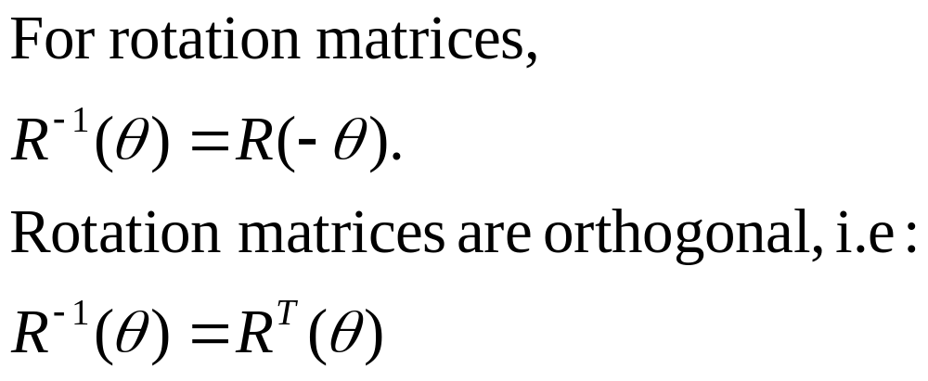
Homogeneous form of rotation.
i.e. the inverse is the transpose

Slide 23
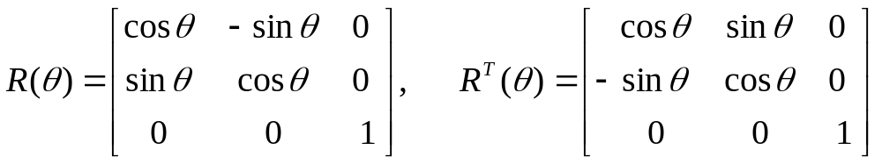
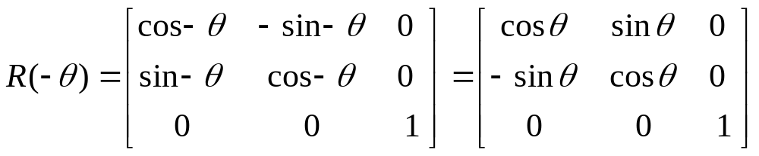
Orthogonality of rotation matrices.

Slide 24
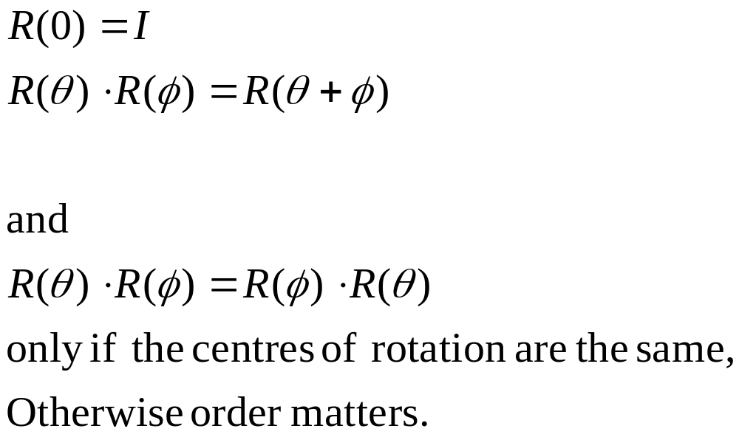
Other properties of rotation.

Slide 25
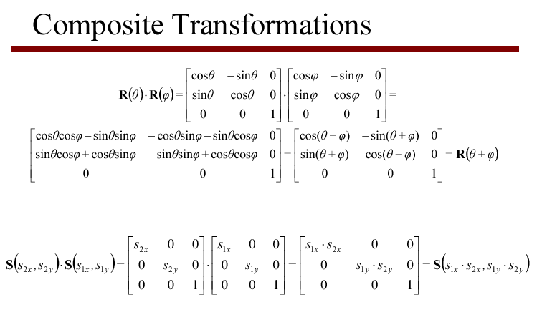

Slide 26
2D Composite Transformations
Combine transformations of different type
  translate, rotate, translate
  translate, scale, translate
  translate, reflect, translate
Use to rotate or scale an object w.r.t. a point that is not the origin
Implement by multiplication of the corresponding homogeneous matrices

Slide 27
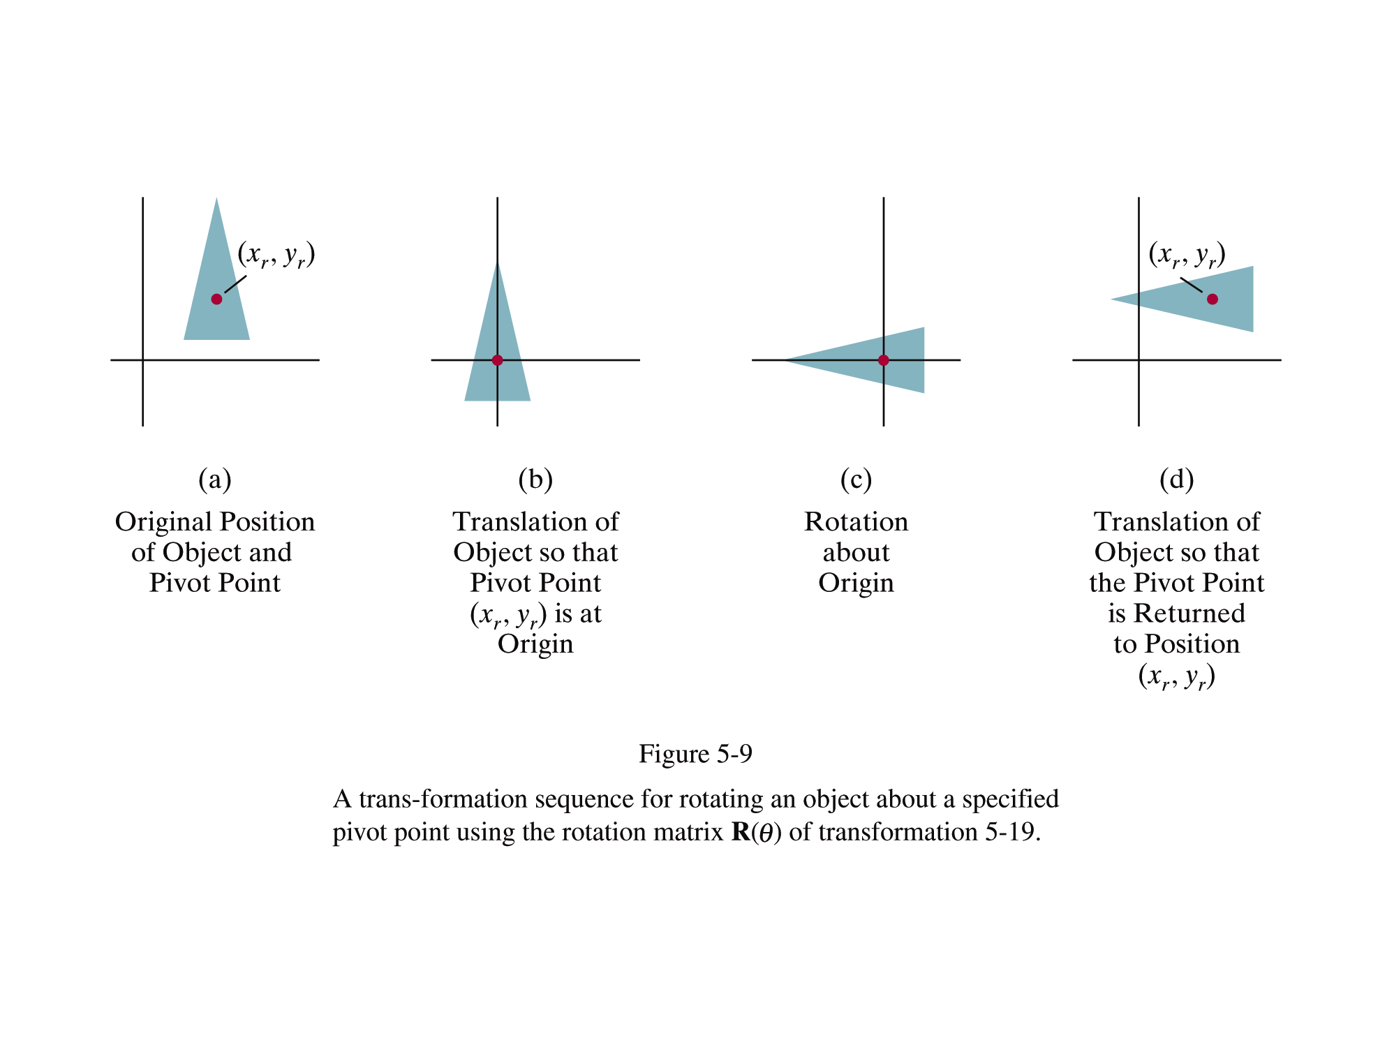

Slide 28
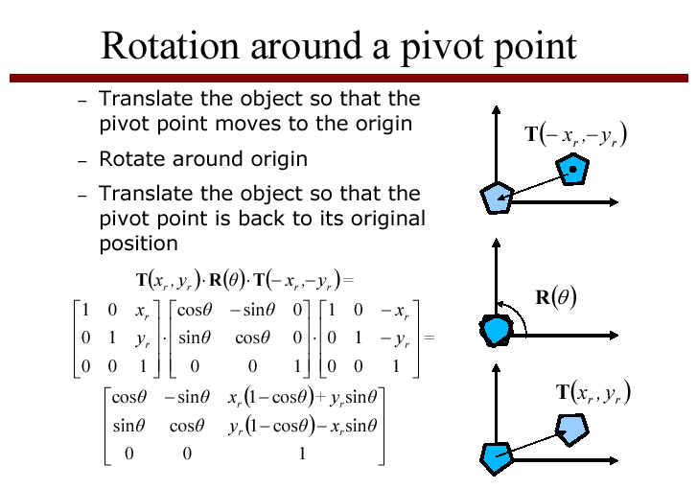

Slide 29
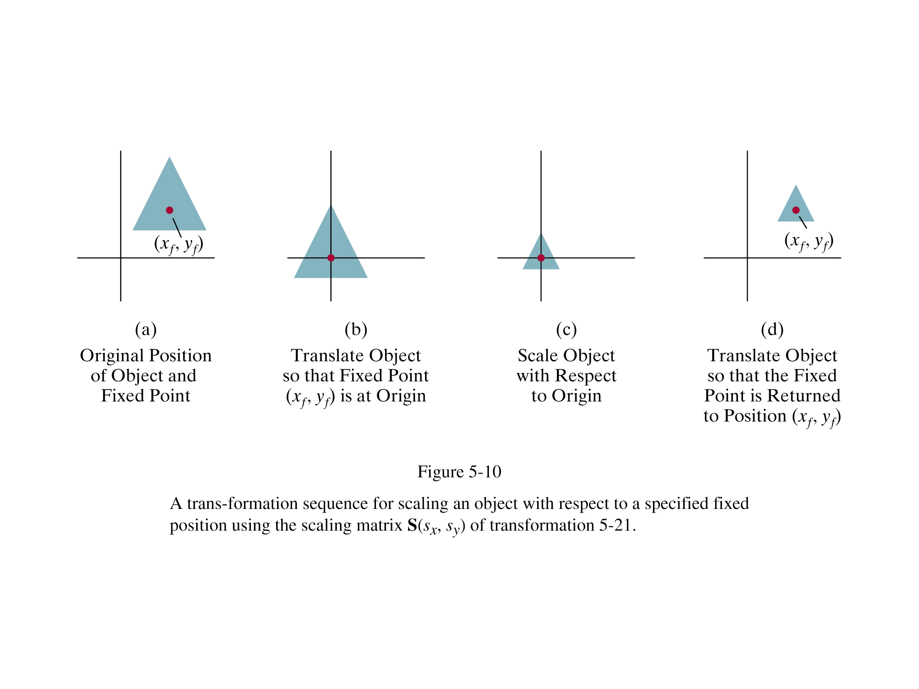

Slide 30
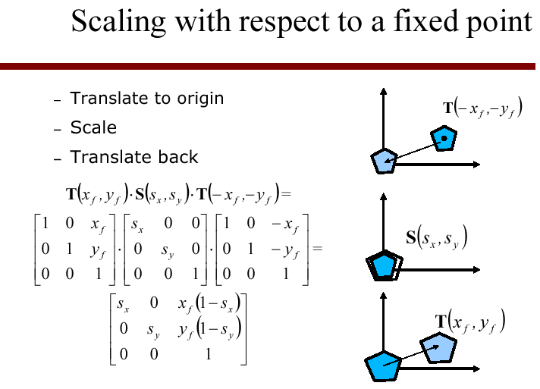

Slide 31
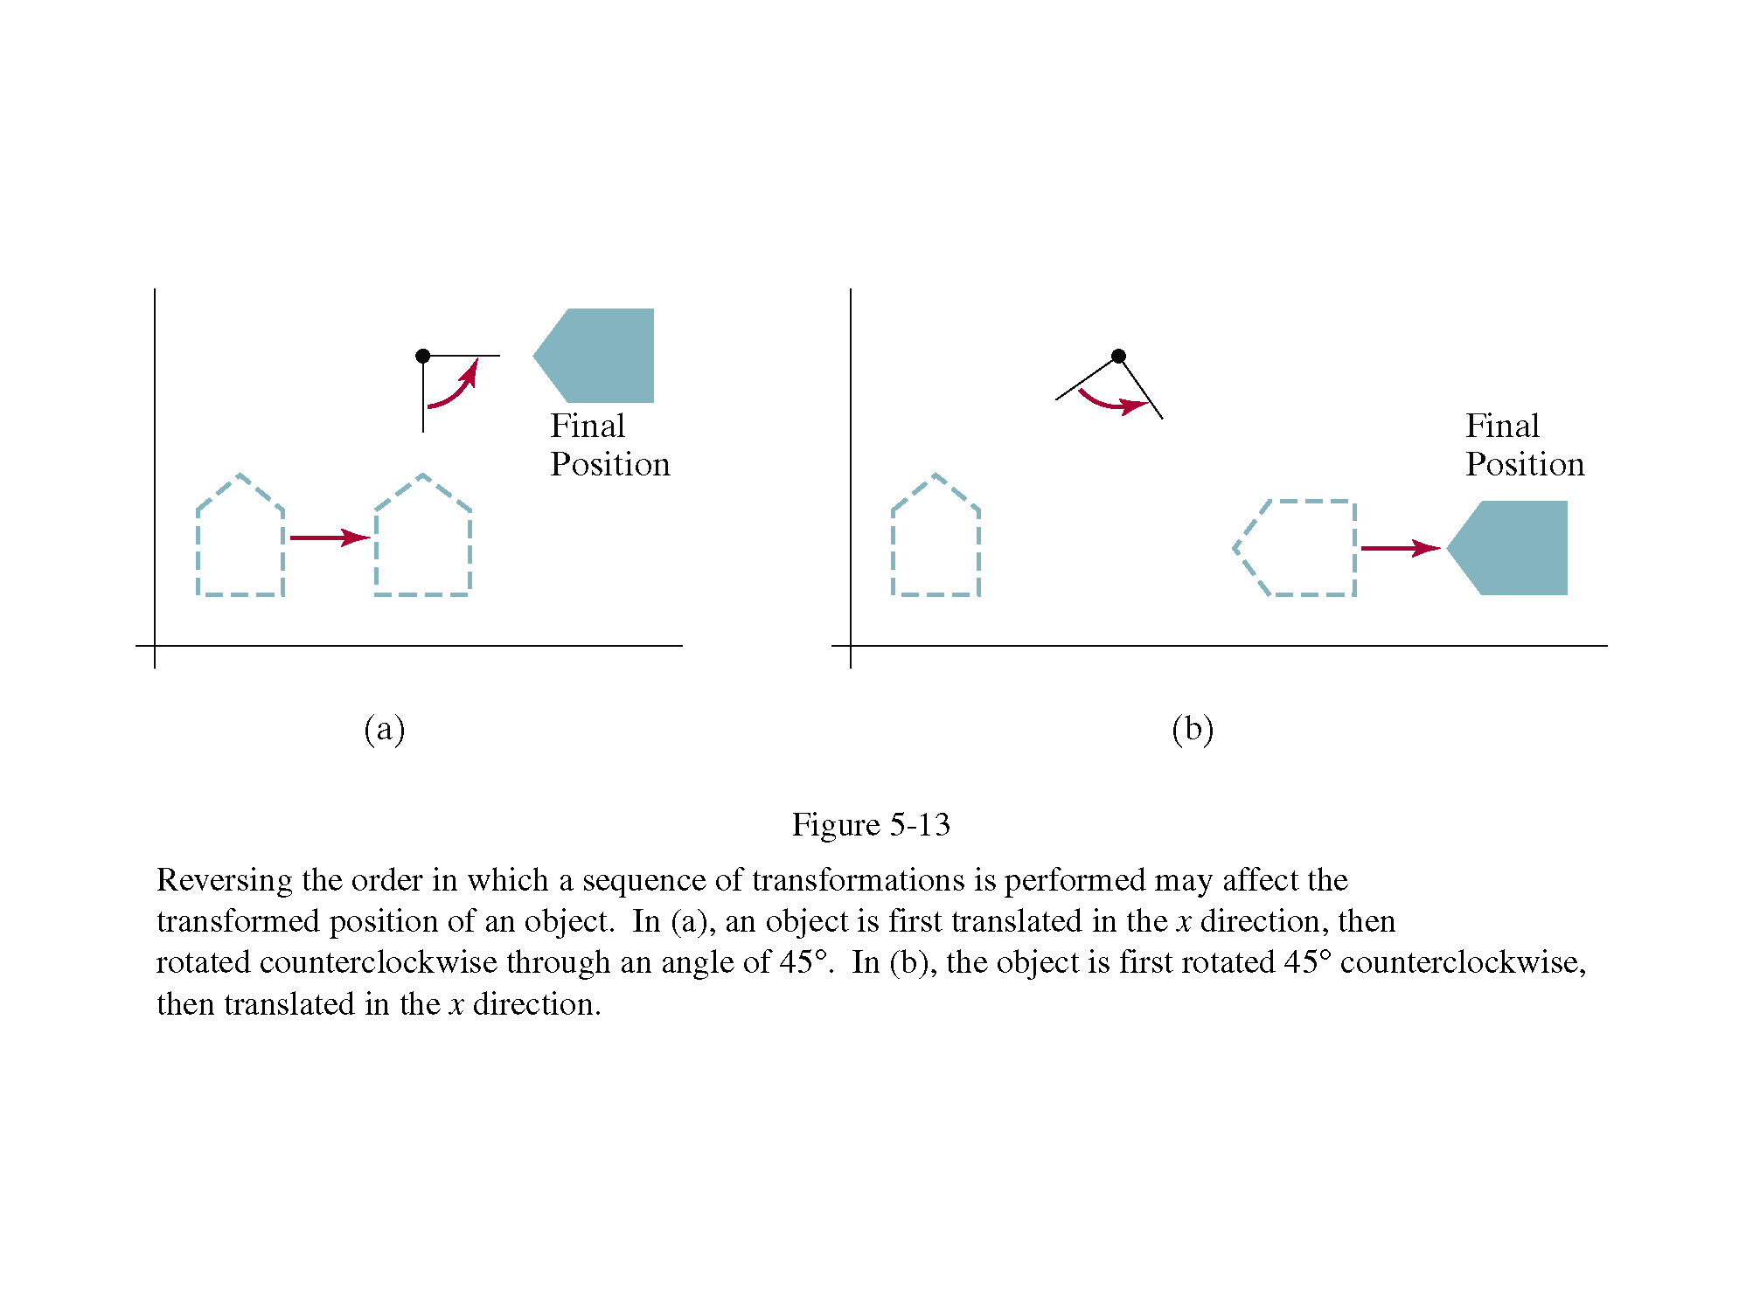
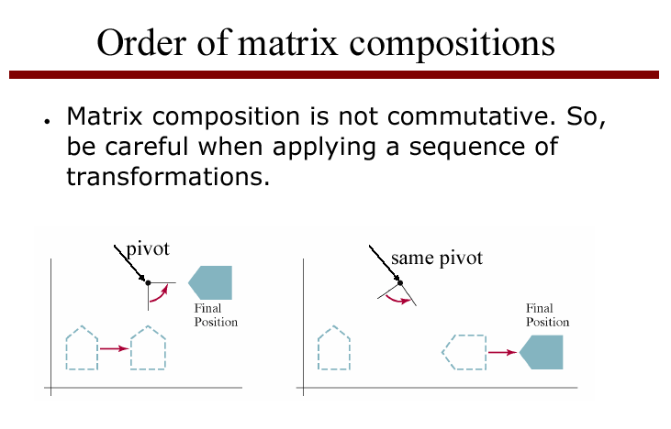

Slide 32
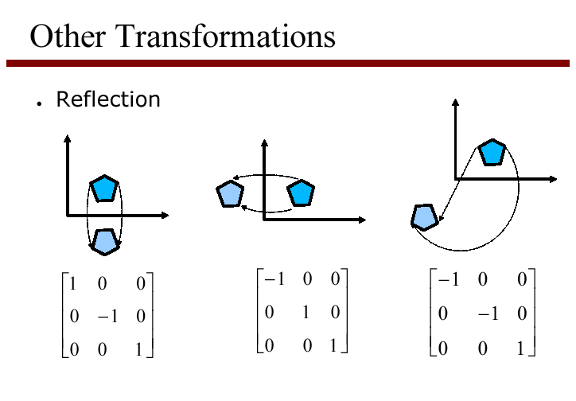
reflection in x and y axes
reflection in origin

Slide 33
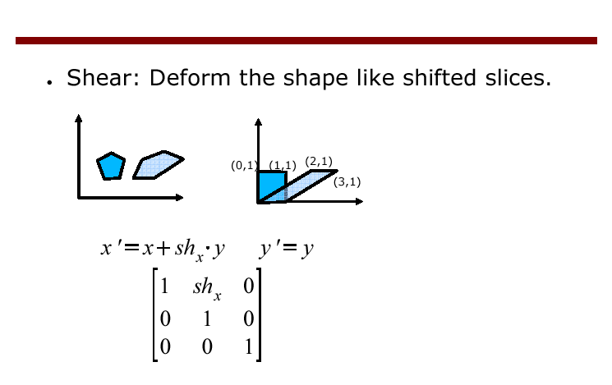
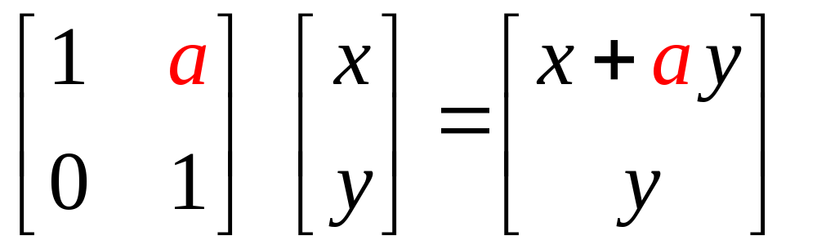
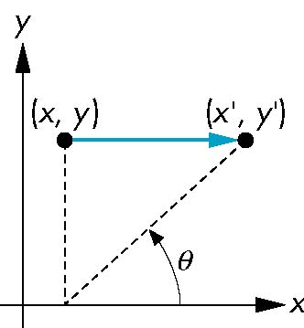
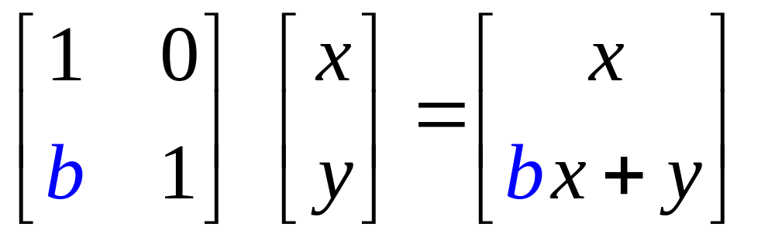
Sh_{x} gives the slope of a vertical line after shear, as dx/dy

Slide 34
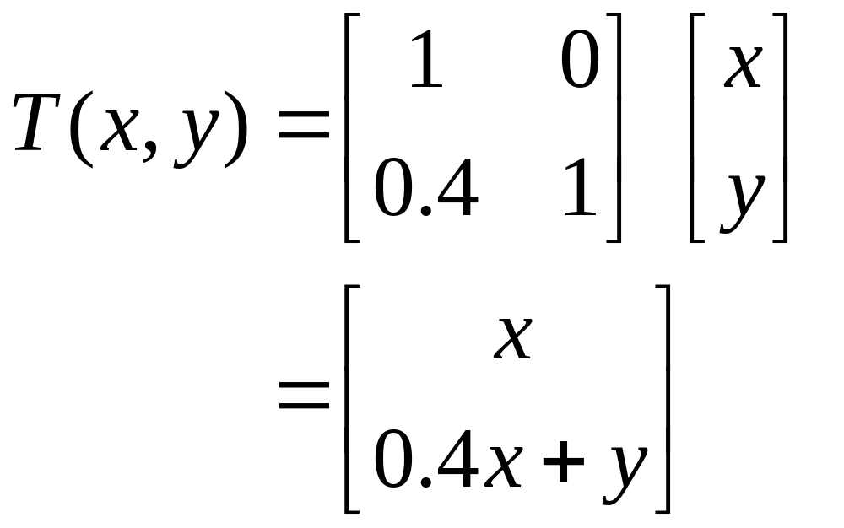
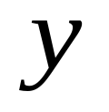
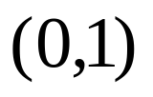
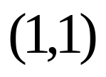
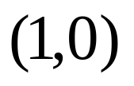

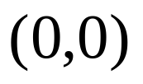
Example 1
S

Slide 35
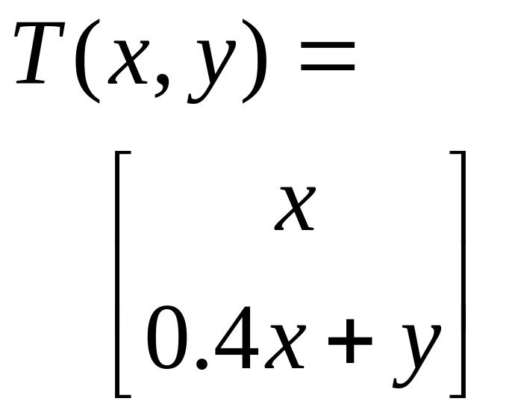
Example 1
S

Slide 36
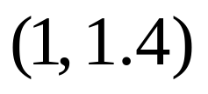
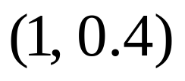
Example 1
T(S)

Slide 37
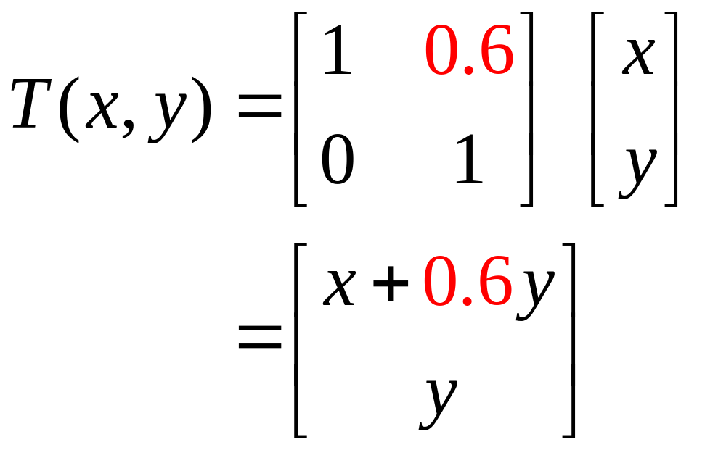
Example 2
S

Slide 38
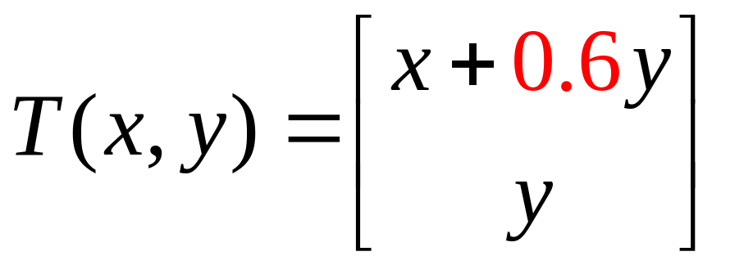
Example 2
S

Slide 39
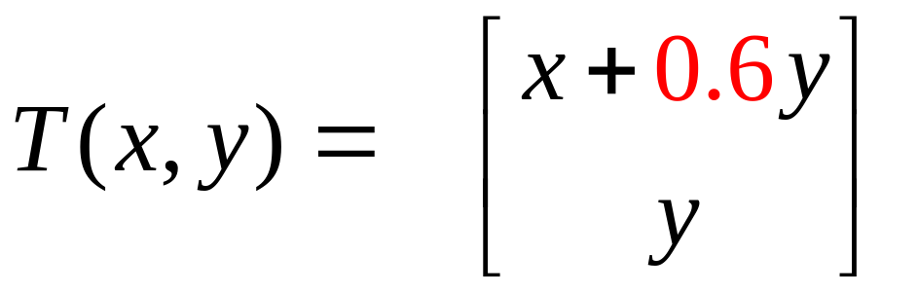



Example 2
T(S)

Slide 40
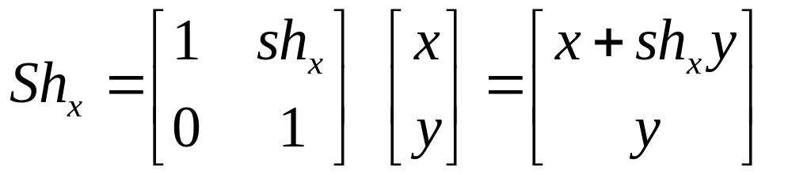
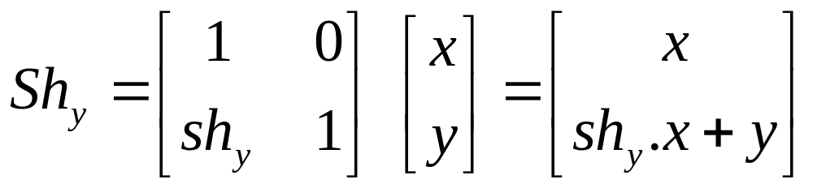
Summary
Shear in x:
Shear in y:

Slide 41
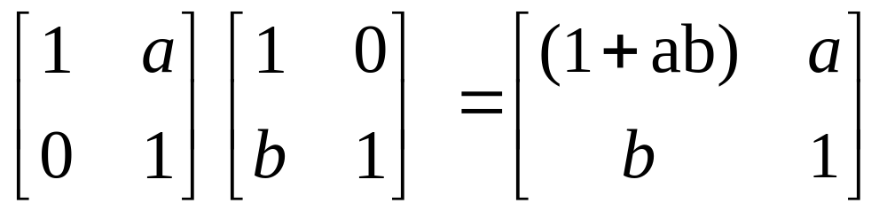
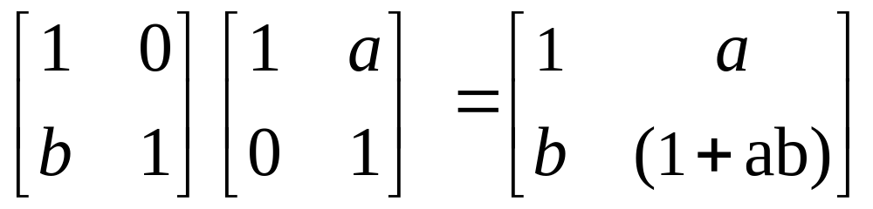
Double Shear: not commutative!

Slide 42

Shear Matrix defined by angle, not slope
e.g. simple shear along x axis
x’ = x + y cot θ
y’ = y
z’ = z
H(θ) =

Slide 43


Slide 44


Slide 45


Slide 46


Slide 47


Slide 48
3D Transformations.
Use homogeneous coordinates, just as in 2D case.
Transformations are now 4x4 matrices.
We will use a right-handed (world) coordinate system - ( z out of page ).
y
Note:
Convenient to think of display as
Being left-handed !!
( z into the screen )
x
z (out of page)

Slide 49

Simple extension to the 3D case:

Slide 50

Scale in 3D.
Simple extension to the 3D case:

Slide 51

Rotation in 3D
Need to specify which axis the rotation is about.
z-axis rotation is the same as the 2D case.

Slide 52


Slide 53


Slide 54


Slide 55

Rotation around an axis parallel to x-axis

Slide 56


Slide 57


Slide 58


Slide 59

α

Slide 60


Slide 61

H&B p271

Slide 62

Rows of upper-left 3x3 submatrix, when rotated by R lie on the x,y and z axes

Slide 63


Slide 64

Scaling an object with this transformation will also move its position relative to the origin - so move it to the origin, scale it, then move it back...

Slide 65


Slide 66


Slide 67


Slide 68


